Slide 1
3. Unit 3
This unit contains following topics:
Linked list ADT’s (linear, double and circular)
Stacks (using static and dynamic lists)
Application of stacks
Queue ( linear and circular)
Data Structure BY S.R. Sharma

Slide 2
Double linked list
In single linked list we can travels only one direction at a time because each node has address of next node only. If we are the middle of linked list an we have to do operation just previous of current node we have to go from start. So this is a drawback of single linked list to over come this we use the new linked list called double linked list. In which we can traverse in both way previous node and next node. The data structure for double linked list is:
struct node {
struct node *prev
int info;
struct node*next
}
Data Structure BY S.R. Sharma

Slide 3
Cont..
Node in double linked list.
Here prev point to the address of previous node and next contains the address of next node in linked list.
Prev info next
Data Structure BY S.R. Sharma

Slide 4
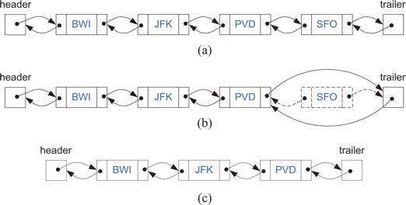
Data Structure BY S.R. Sharma

Slide 5
Traverse a double linked list
We take ptr as a pointer variable. Here start points to the first elements of list. Initially we assign the value of start to ptr. So ptr also points to the first node in list. For processing the next elements we assign the address of next node to ptr as:
ptr=ptr->next
We will use while loop to go up to end as
while(ptr!=NULL)
ptr=ptr->next;
Data Structure BY S.R. Sharma

Slide 6
Insert into double linked list
Like as the single linked list the insert operation in double linked list are as
Insertion at beginning
Insertion in between
the insert at beginning is as;
tmp->next=start;
start->prev=tmp;
now
start=tmp;
Data Structure BY S.R. Sharma

Slide 7
addatbeg(int num) { struct node *tmp; tmp=malloc(sizeof(struct node)); tmp->prev=NULL; tmp->info=num; tmp->next=start; start->prev=tmp; start=tmp; }/*End of addatbeg()*/
Data Structure BY S.R. Sharma

Slide 8
In between
To insert the node in between of double linked list is as:
q points to the previous node after which data is to be insert so
q->next->prev=tmp;
tmp->next=q->next;
tmp->prev=q;
q->next =tmp;
Data Structure BY S.R. Sharma

Slide 9
addafter(int num,int c) { struct node *tmp,*q; int i; q=start; for(i=0;i<c-1;i++) { q=q->next; if(q==NULL) { printf("There are less than %d elements\n",c); return; } | } tmp=malloc(sizeof(struct node) ); tmp->info=num; q->next->prev=tmp; tmp->next=q->next; tmp->prev=q; q->next=tmp; }/*End of addafter() */
Data Structure BY S.R. Sharma

Slide 10
Delete operation
The deletion operation of double linked list is as same as single linked list.
once try its yourself ok
Data Structure BY S.R. Sharma

Slide 11
del(int num) { struct node *tmp,*q; if(start->info==num) { tmp=start; start=start->next; /*first element deleted*/ start->prev = NULL; free(tmp); return; } q=start; while(q->next->next!=NULL) { if(q->next->info==num) /*Element deleted in between*/ { | tmp=q->next; q->next=tmp->next; tmp->next->prev=q; free(tmp); return; } q=q->next; } if(q->next->info==num) /*last element deleted*/ { tmp=q->next; free(tmp); q->next=NULL; return; } printf("Element %d not found\n",num); }/*End of del()*/
Data Structure BY S.R. Sharma

Slide 12
THANK YOU
Data Structure BY S.R. Sharma

